Slide 1
Desired State Configuration
Jan-Hendrik Peters @ SCOTPSUG

Slide 2
Agenda
Introduction to Desired State Configuration
Overview
Components
Security
Push
Pull
Server 2016
Server vNext
DSC in release pipelines
Advanced DSC – Customer showcase

Slide 3
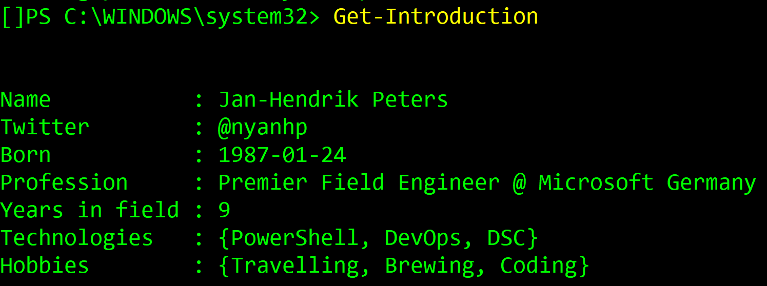
About me
Jan-Hendrik.Peters@microsoft.com
me@janhendrikpeters.de

Slide 4
Overview
Introduced with WMF 4
Much improved with WMF 5
Management platform in Windows PowerShell
Support Infrastructure as Code through PowerShell
Apply and enforce a desired state

Slide 5
Cmdlets by version
CommandType Name | WMF 4.0 | KB3000850 | WMF 5.0
 |  | Nov-2014
Function Configuration | ü | ü | ü
Function Get-DscConfiguration | ü | ü | ü
Function Get-DscLocalConfigurationManager | ü | ü | ü
Function Get-DscResource | ü | ü | ü
Function New-DSCCheckSum | ü | ü | ü
Function Restore-DscConfiguration | ü | ü | ü
Function Test-DscConfiguration | ü | ü | ü
Cmdlet Set-DscLocalConfigurationManager | ü | ü | ü
Cmdlet Start-DscConfiguration | ü | ü | ü
Function Remove-DscConfigurationDocument |  | ü | ü
Function Stop-DscConfiguration |  | ü | ü
Cmdlet Update-DscConfiguration |  | ü | ü
Function Find-DscResource |  |  | ü
Function Get-DscConfigurationStatus |  |  | ü
Cmdlet Invoke-DscResource |  |  | ü
Cmdlet Publish-DscConfiguration |  |  | ü
Function Enable-DscDebug |  |  | ü
Function Disable-DscDebug |  |  | ü

Slide 6
Imperative vs Declarative
New-Service -Name NaaS -BinaryPathName C:\Windows\notepad.exe -DisplayName NaaS -StartupType Automatic
Vs
Service notepadasaservice
{
Name = 'NaaS'
DisplayName = 'NaaS'
Path = 'C:\Windows\notepad.exe'
StartupType = 'Automatic'
}

Slide 7
When to use DSC?
Automated configuration of a set of computers
Scripts
Environment Variables
Registry
Repair
Desired
State
Report
Desired
State
Deploy
Software
Roles and
Features
Files and
Directories
Processes and Services
Users and
Groups

Slide 8
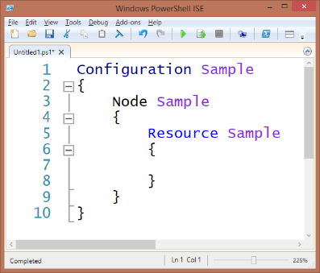
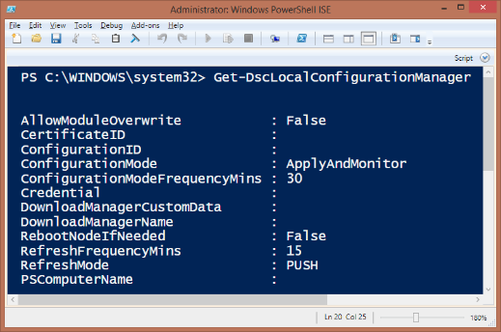
Components
Configuration
Resources
MOF files
Local Configuration Manager
Pull server
DSC

Slide 9
Why not Group Policy?
DSC
No domain needed
No network needed
MOF-based (open standard)
Heavily extensible
Flexible Authentication
WMF 4.0 at least required
Steep learning curve for traditional admins
GPO
Only in domain environment
Generally requires network
Born from registry control
Easy to setup and deploy
Very well-known and established

Slide 10



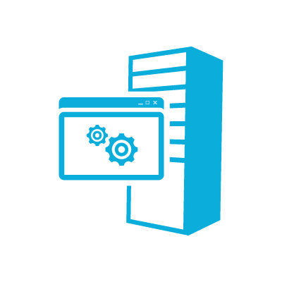

Distribution
Authoring
Staging
Nodes
Config Pushed
Config Pulled
Server1
Configs Deployed
Server1.mof
Config Pulled
Server1.mof
IIS
Server1
Server1.mof
Configs Deployed
Server1.mof
Server1

Slide 11
Components – Configuration
Separates the what from the where
What: Configuration logic
Where: Node data
Reusable code with different config data
Contains the desired state
Optional Node blocks
Resource blocks
Simpler than a script, human-readable and declarative

Slide 12
Components - Resources
Resources implement the configuration
Contain the actual PowerShell code required to reach the desired state
Used in configurations
Can work with dependencies and credentials
Contained within PowerShell modules

Slide 13
Components – Community Resources
Only very little built-in resources
Community resources greatly extend DSC
Give and take: Contribute to the success of others and others will contribute to your success

Slide 14
Lab 1 – Task 01 and Task 02
https://lab.janhendrikpeters.de/rdweb/webclient
Baby steps…
User: contoso\studentXX – 01 – 20
PW: Somepass1
Install the VSCode PowerShell Extension or use the ISE

Slide 15
DSC Security
DSC runs as Local System
Access to networked resources
…by granting the computer accounts access
…by using the PSDSCRunAsCredential automatic property
Many resources use their own credential properties
SQLSetup for all service accounts plus source credentials
Many more
Credentials need to be encrypted!

Slide 16

DSC Security: Certificates
SSL WebServer Cert
PKI
Server
Doc. Encr.
Pull
Server
All Node Document Encryption Cert Export
Build
Server
Target Nodes
Public Key Export
& Thumbprint
Notes:
Encrypted MOFs using DPAPI
https://msdn.microsoft.com/en-us/powershell/wmf/dsc_encryptedmof
https://msdn.microsoft.com/en-us/library/ms995355.aspx
Breaking Change: Certificates used to encrypt/decrypt passwords in DSC configurations may not work after installing WMF 5.0 RTM
Allows long passwords, required document encryption certificate
https://msdn.microsoft.com/en-us/powershell/wmf/limitation_dsc
Securing the MOF File
https://msdn.microsoft.com/en-us/powershell/dsc/securemof

Slide 17
Demo
Using credentials
Using configuration data

Slide 18

Lab 2
https://lab.janhendrikpeters.de/rdweb/webclient
Configuration data
User: contoso\StudentXX
PW: Somepass1
Try the config data hashtable vs hardcoded settings

Slide 19
Push
Active deployment of configuration files
CIM remoting is used to connect to target nodes
Well suited for a CI/CD pipeline
Artefacts (MOF files) are pushed during a release
Allows incorporating the results in integration tests
Required to configure the LCM
Requires the resource modules to be on the node
Can optionally use pull server to download resource modules

Slide 20
Pull – Before 1803/Server 2019
IIS web application or SMB share holding
Configurations
Modules
Reporting (* not with SMB)
IIS: Uses local JetDB for node data
Reporting essentially not possible without hacks/workarounds
Scaling issues: devices.edb filled up too fast
Not possible in HA configuration

Slide 21
Demo
LCM configuration
Azure Automation pull server

Slide 22
Lab 3
https://lab.janhendrikpeters.de/rdweb/webclient
Configure the LCM for pull
Use the solution in .\Solutions\Lab3.ps1 and add the registration key
Change node to StudentXX

Slide 23
Pull Server 1803/Server 2019
Native SQL connection officially possible
Allows SQL reporting with tool like SSRS
Much better scalable
High availability configuration easily possible with
Load-balanced web server
HA database
Easy to configure and use, database will be created automatically

Slide 24
Demo
Pull Server Setup

Slide 25
Lab 4
https://lab.janhendrikpeters.de/rdweb/webclient
Setup the pull server

Slide 26
DSC in a Release Pipeline
Infrastructure as Code lends itself to code repositories
Changes are tested by the DevOps people in their own fork
Unit and Integration tests ensure proper code
Pull Request into development branch will trigger
Unit and Integration tests
Generation of build artefacts
Release of build artefacts via push to development environment
Release into master will trigger release in to production environment

Slide 27
DSC in a release pipeline continued
Configuration data is key
Separation of configuration from data is very important
Principle of „Don‘t repeat yourself“ becomes even more important

Slide 28
Datum – Configuration Data generation
https://github.com/gaelcolas/datum
PowerShell module to generate configuration data
Uses hierarchical model with inheritance
Enables policy-driven infrastructure with DSC

Slide 29
Demo
Customer scenario: Mobile data center

